Slide 1
E-commerce Trends Analysis using SQL
Insights on Sales, Customers, and Operations
--- TEAM 4
Notes:
1

Slide 2



Abstract: SQL in E-commerce
This presentation shows how SQL can be used to study e-commerce data. By looking at sales, customer behaviour, and daily operations, businesses can make smarter decisions that help them grow and work more efficiently.
Sales Trends
Customer Behaviour
Operational Efficiency
Identify top-performing products and revenue streams.
Understand purchasing patterns and customer segments.
Optimise inventory, pricing, and shipping logistics.
Notes:
2

Slide 3
E-commerce Database Schema
E The foundation of our analysis is a well-structured database. Our schema includes key tables such as Users, Customers, Products, Orders, OrderDetails, Coupons, OrderCoupons, ProductReviews, Shipments, and Cart. This design facilitates comprehensive data retrieval and analysis across various e-commerce functions.
  Users: Manages login and system roles.
  Customers: Stores customer details.
  Products: Contains information about available items.
  Orders & OrderDetails: Manage transactions and item breakdowns.
  Coupons & OrderCoupons: Handle discounts and coupon applications.
  ProductReviews: Stores customer feedback and ratings.
  Shipments: Tracks order shipping and delivery status.
  Cart: Maintains temporary selections before checkout.
Notes:
4

Slide 4
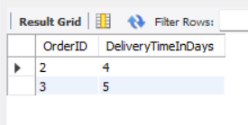
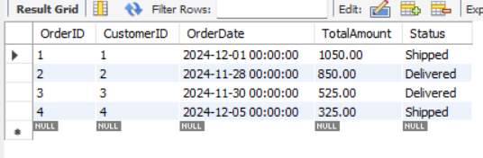
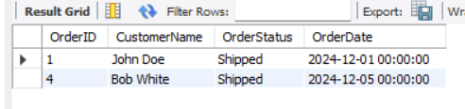
Operational Efficiency: Streamlining Processes
Create a view that shows all orders along with customer names and order statuses, and how can you query this view to get all 'Shipped' orders?
What is the delivery time for each completed order?
CREATE VIEW OrderSummary AS
SELECT
o.OrderID,
c.Name AS CustomerName,
o.Status AS OrderStatus,
o.OrderDate
FROM Orders o
JOIN Customers c ON o.CustomerID = c.CustomerID;
SELECT * FROM OrderSummary
WHERE OrderStatus = 'Shipped';
Which orders were placed in the year 2024?
SELECT
OrderID,
DATEDIFF(DeliveredDate, ShippedDate) AS DeliveryTimeInDays
FROM Shipments
WHERE Status = 'Delivered';
SELECT OrderID, CustomerID, OrderDate, TotalAmount, Status
FROM Orders
WHERE YEAR(OrderDate) = 2024;
Notes:
9

Slide 5
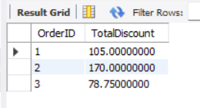
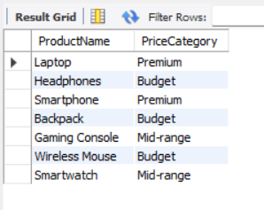
Discounts & Pricing Strategies
How much discount has been applied to each order?
How can products be categorized by price range?
SELECT ProductName,
CASE
WHEN Price < 100 THEN 'Budget'
WHEN Price BETWEEN 100 AND 500 THEN 'Mid-range'
ELSE 'Premium'
END AS PriceCategory
FROM Products;
SELECT O.OrderID, SUM((C.DiscountPercentage/100) * O.TotalAmount) AS TotalDiscount
FROM OrderCoupons OC
JOIN Orders O ON OC.OrderID = O.OrderID
JOIN Coupons C ON OC.CouponID = C.CouponID
GROUP BY O.OrderID;
Notes:
6

Slide 6
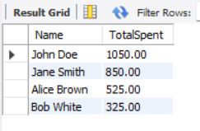
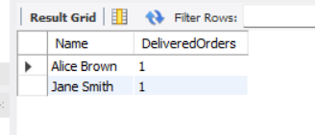
Customer Insights: Understanding Our Patrons
Which customers have spent the most?
How many unique delivered orders were made by each customer?
SELECT C.Name, SUM(O.TotalAmount) AS TotalSpent
FROM Customers C
JOIN Orders O ON C.CustomerID = O.CustomerID
GROUP BY C.Name
ORDER BY TotalSpent DESC
LIMIT 5;
SELECT C.Name, COUNT(DISTINCT O.OrderID) AS DeliveredOrders
FROM Customers C
JOIN Orders O ON C.CustomerID = O.CustomerID
WHERE O.Status = 'Delivered'
GROUP BY C.Name;
Notes:
7

Slide 7
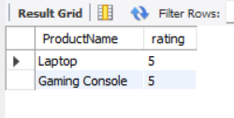
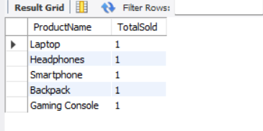
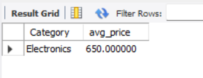
Product Insights: What Sells and How It's Rated
What are the average prices of products by category, filtered to only show categories with an average price greater than $100?
What are the top 5 best-selling products?
Which products have received 5-star reviews?
SELECT P.ProductName, SUM(OD.Quantity) AS TotalSold
FROM OrderDetails OD
JOIN Products P ON OD.ProductID = P.ProductID
GROUP BY P.ProductName
ORDER BY TotalSold DESC
LIMIT 5;
SELECT DISTINCT p.ProductName,rating
FROM products p
JOIN productreviews r ON p.productID = r.productID
WHERE r.rating = 5;
SELECT Category,AVG(price) AS avg_price
From products
Group by category
Having AVG(price) >100;
Notes:
5

Slide 8
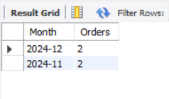
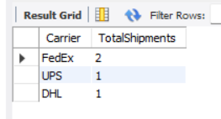
Order & Shipment Trends: Tracking the Journey
How many orders were placed each month?
How many shipments were handled by each carrier?
SELECT
Carrier,
COUNT(ShipmentID) AS TotalShipments
FROM Shipments
GROUP BY Carrier
ORDER BY TotalShipments DESC;
SELECT DATE_FORMAT(OrderDate, '%Y-%m') AS Month, COUNT(OrderID) AS Orders
FROM Orders
GROUP BY DATE_FORMAT(OrderDate, '%Y-%m');
Notes:
8

Slide 9

Conclusion & Next Steps
SQL is a powerful tool for deriving actionable insights from e-commerce data. The analytical framework
presented enables a deeper understanding of sales, customers, and operational performance.
  Provides key insights for improving sales strategy, product performance, customer
  engagement, and operational efficiency.
  Enables generation of reports to monitor business trends.
  Helps identify top-performing products.
  Assists in evaluating marketing campaigns.
  Tracks customer behavior effectively.
  Demonstrates the practical use of SQL in real-world e-commerce trend analysis.
Notes:
10

Slide 10
THANK YOUU!!
--- TEAM 4
Notes:
1

